Slide 1
Kids Galaxy Educational Website
Done By – Sazida Sultana Binte Jamal

Slide 2
About Sazida
A react developer who has a wide range of front-end skills. My professional experience includes HTML, CSS, JavaScript, React JS, Bootstrap, Material UI, Firebase, Heroku, Netlify, GitHub, Visual Studio, C, C++, Adobe Illustrator, and Adobe Photoshop. I consider myself a real team player who understands the importance of teamwork, collaboration, and open communication.
Full Name: Sazida Sultana Binte Jamal
Phone No: +8801979010160
https://awesome-tereshkova-4eb3cb.netlify.app
linkedin.com/in/sazida-sultana-binte-jamal-22b147203
https://github.com/lubna
lubnasazida@gmail.com
Chittagong, Bangladesh

Slide 3
Project Features:
Kids Galaxy is a educational website where user can find many course. They can enroll to any courses. If they need help they can contact. It is also responsive.
7 June 2021 – 8 June 2021
Home page- containing navbar, header, Courses, contact form( if a user fill up the form and click on the send button it will come to my email) , and footer.
About us page
Contact us page
Enroll Page- User can enroll to any courses. It will show them a confirmation message, and the information will go to my email. This is a private route.
Login Page
Also has login Authentication (Private Route)
Technology: HTML, CSS, React Js, Material UI, Firebase, Bootstrap, EmailJs.

Slide 4
Code Link:
https://github.com/lubna201/kids-galaxy
Live Site Link:
https://60be814d08a38012652a9059--dreamy-edison-44be63.netlify.app/
Demo Video Link:
https://drive.google.com/file/d/1vrGkbi3Lqq3ixReYbu1_1WlOJeEQxNcf/view?usp=sharing

Slide 5
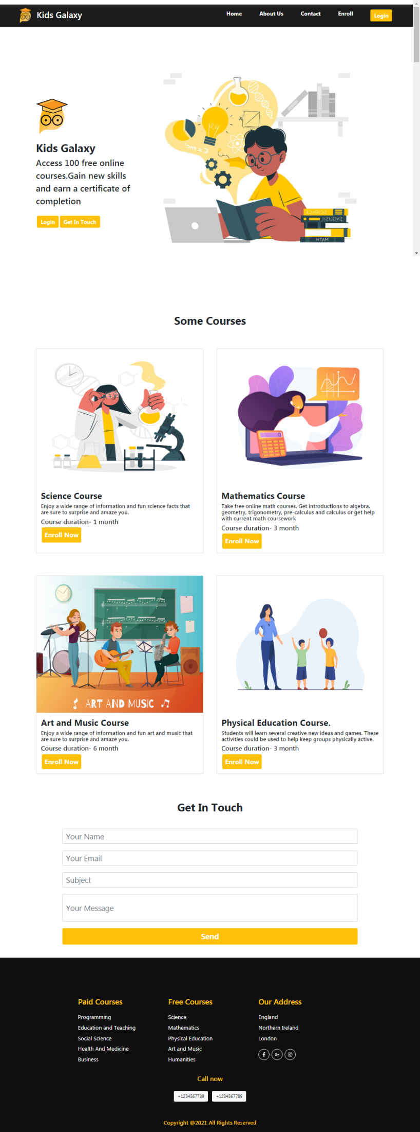
Desktop
Version

Slide 6
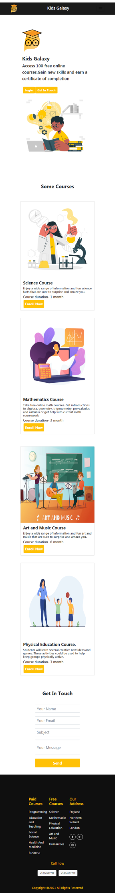
Mobile
Version

Slide 7
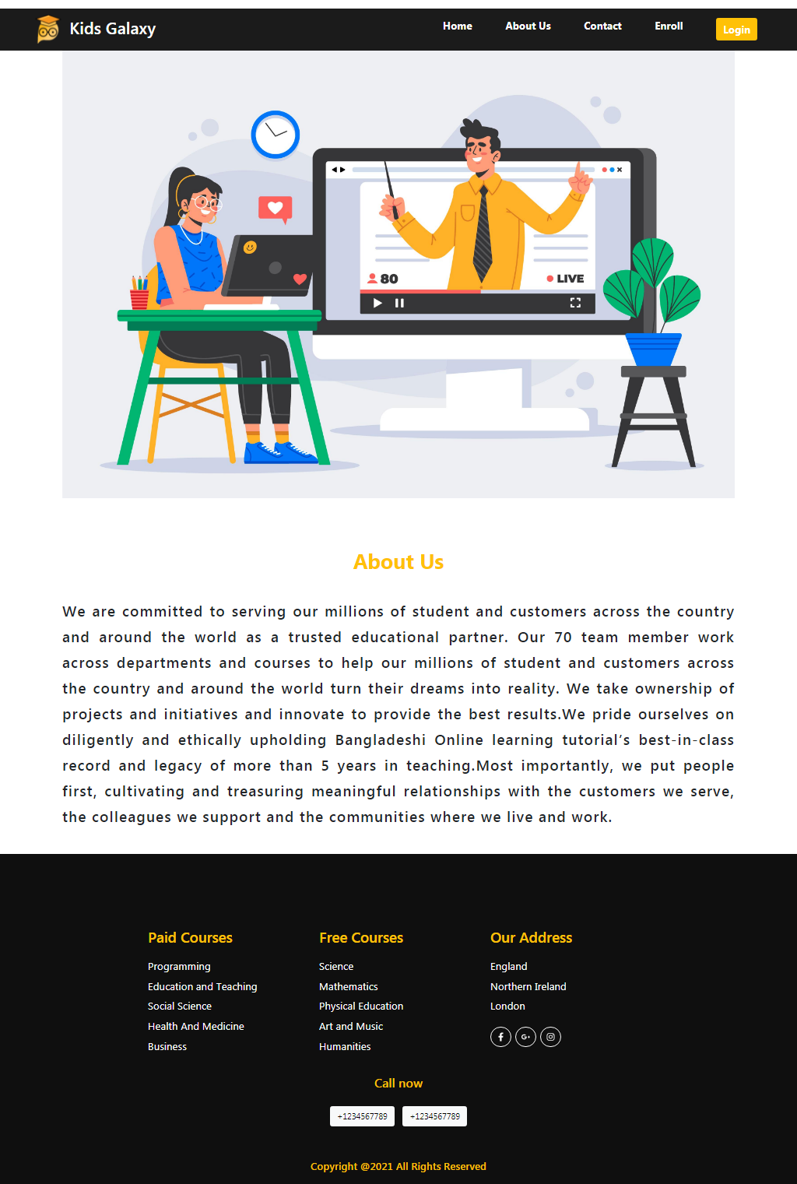
Desktop
Version

Slide 8
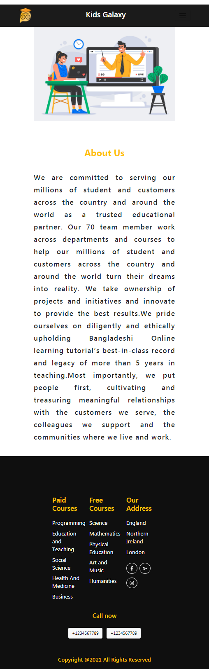
Mobile
Version

Slide 9
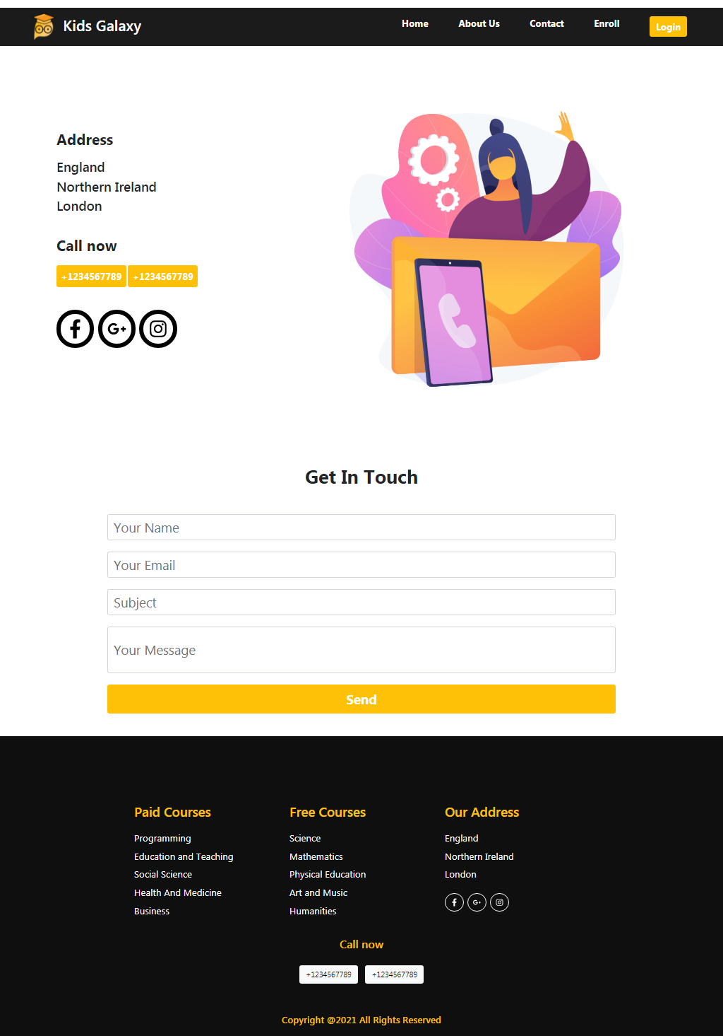
Desktop
Version

Slide 10
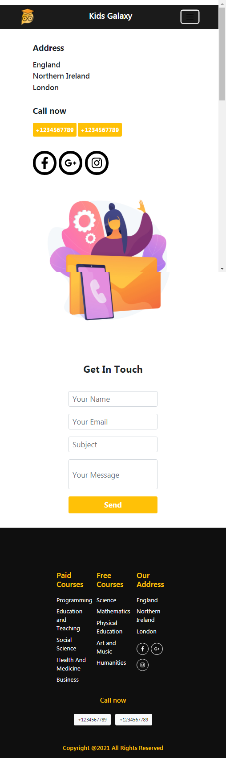
Mobile
Version

Slide 11
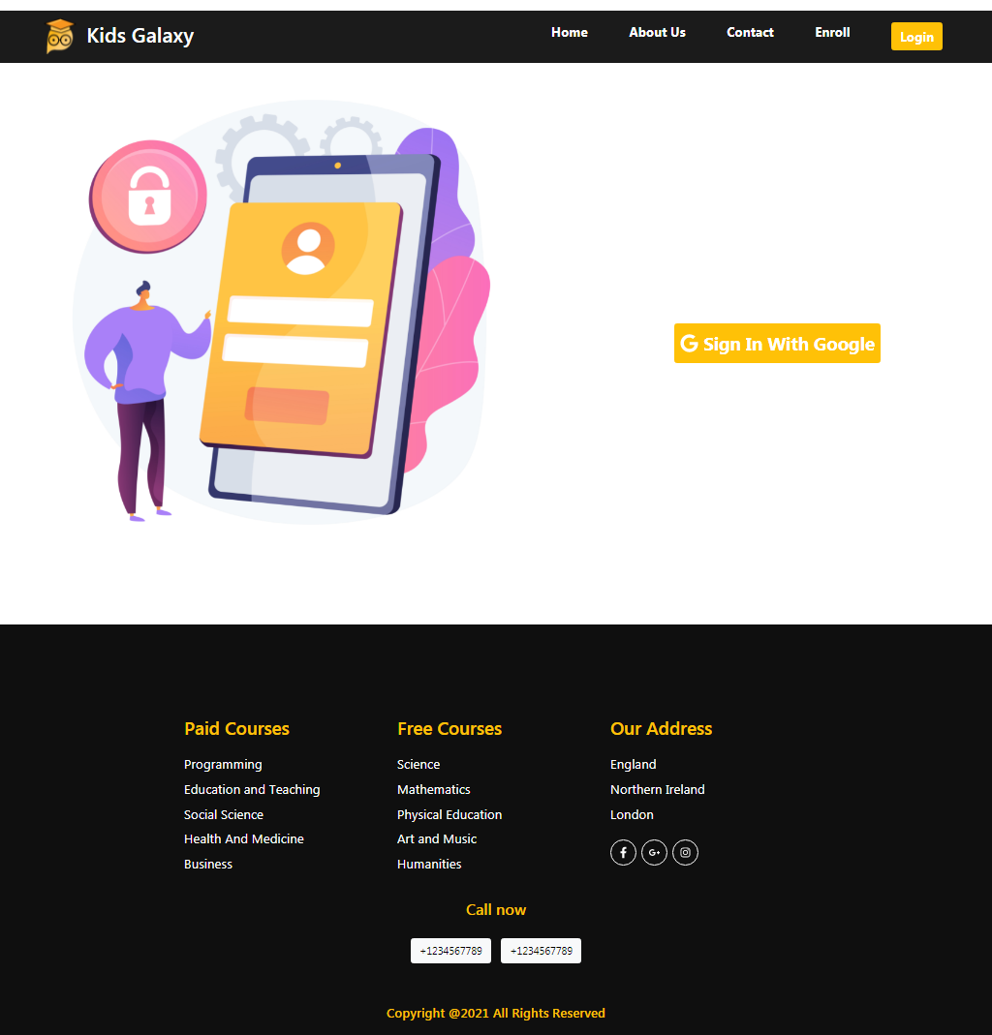
Desktop
Version

Slide 12
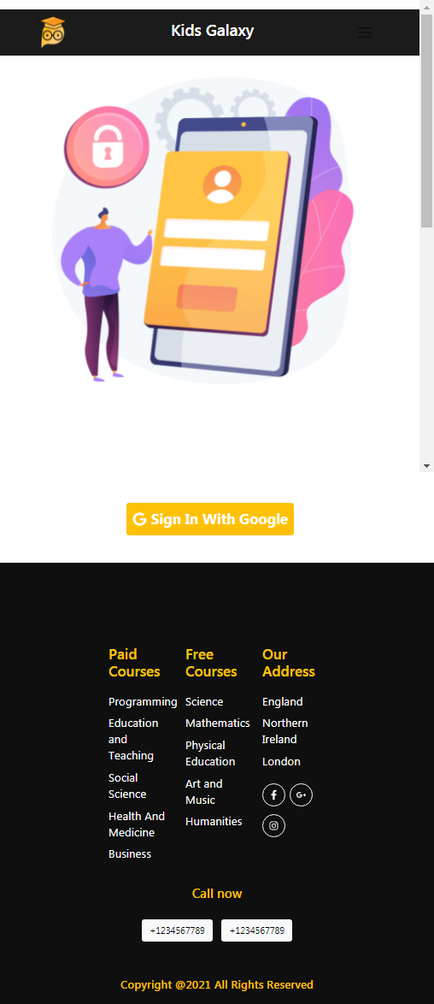
Mobile
Version

Slide 13
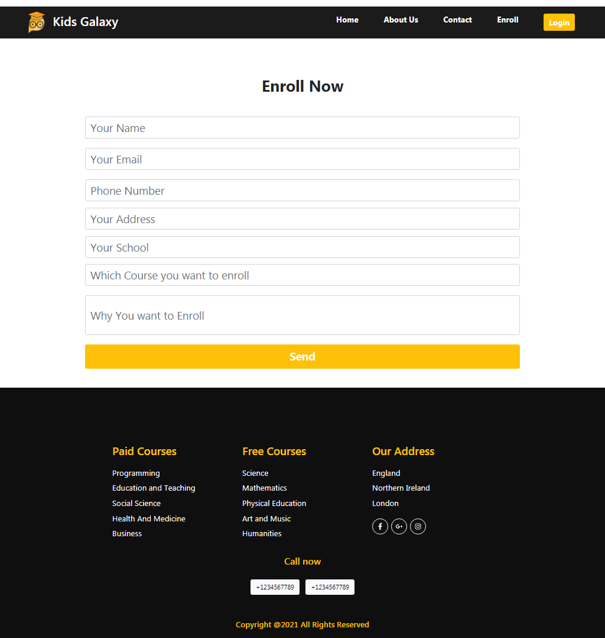
Desktop
Version

Slide 14
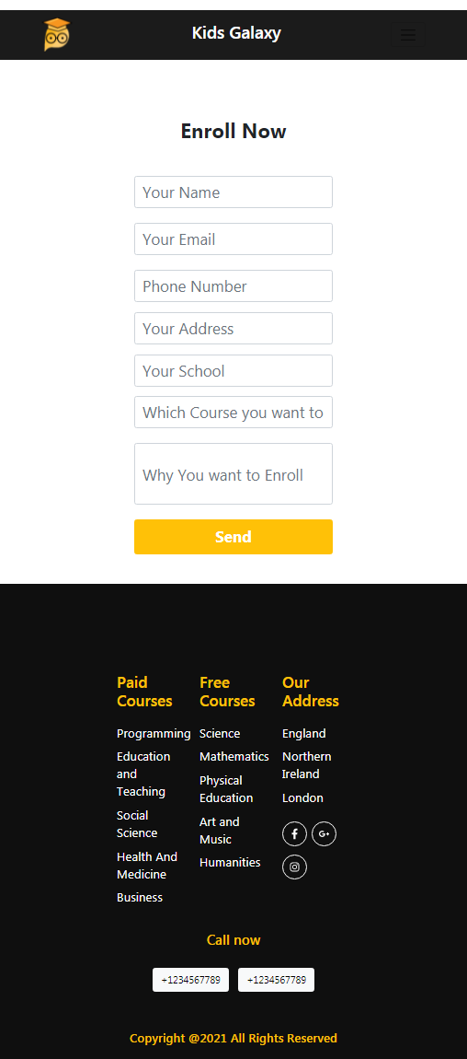
Mobile
Version

Slide 15
Thank You

